Slide 1
Bio550 Spring 2026
Jan 13, 2026

Slide 2
Round about w/ introductions
Class structure:
Topics: open with a theme
Something interesting in the news related to class ?
Constant stress- what does cortisol do to the body?
Constant joy- Dopamine/endorphin high
Cells --- key to it all.

Slide 3
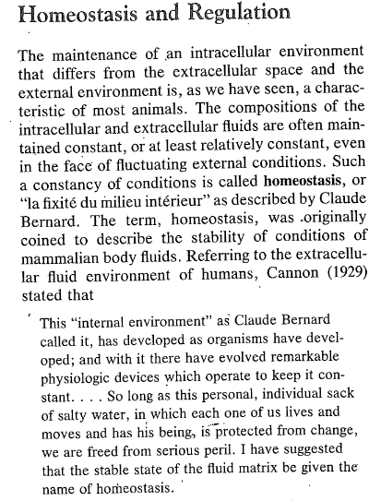

Slide 4

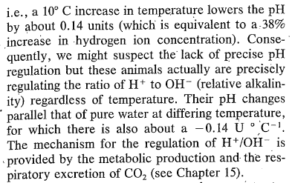
Examples : ?
Discussion- limits, ranges
pH and temp?

Slide 5
And + feedback
Limits- exceptions- not clear has to be in context.
Conformers --- limited …how so ?

Slide 6
https://web.as.uky.edu/Biology/faculty/cooper/Bio550%20Sp%2006/TEACHING550Spring2026.htm#anchor2
Reading of why Comparative Physiology (PDF) and Comparative Neurobiology (PDF).
Week 1 pages 14-27 [PDF]
Start thinking about PDF “Beyond mitochondria:” on web page download

Slide 7
Review quickly

Slide 8
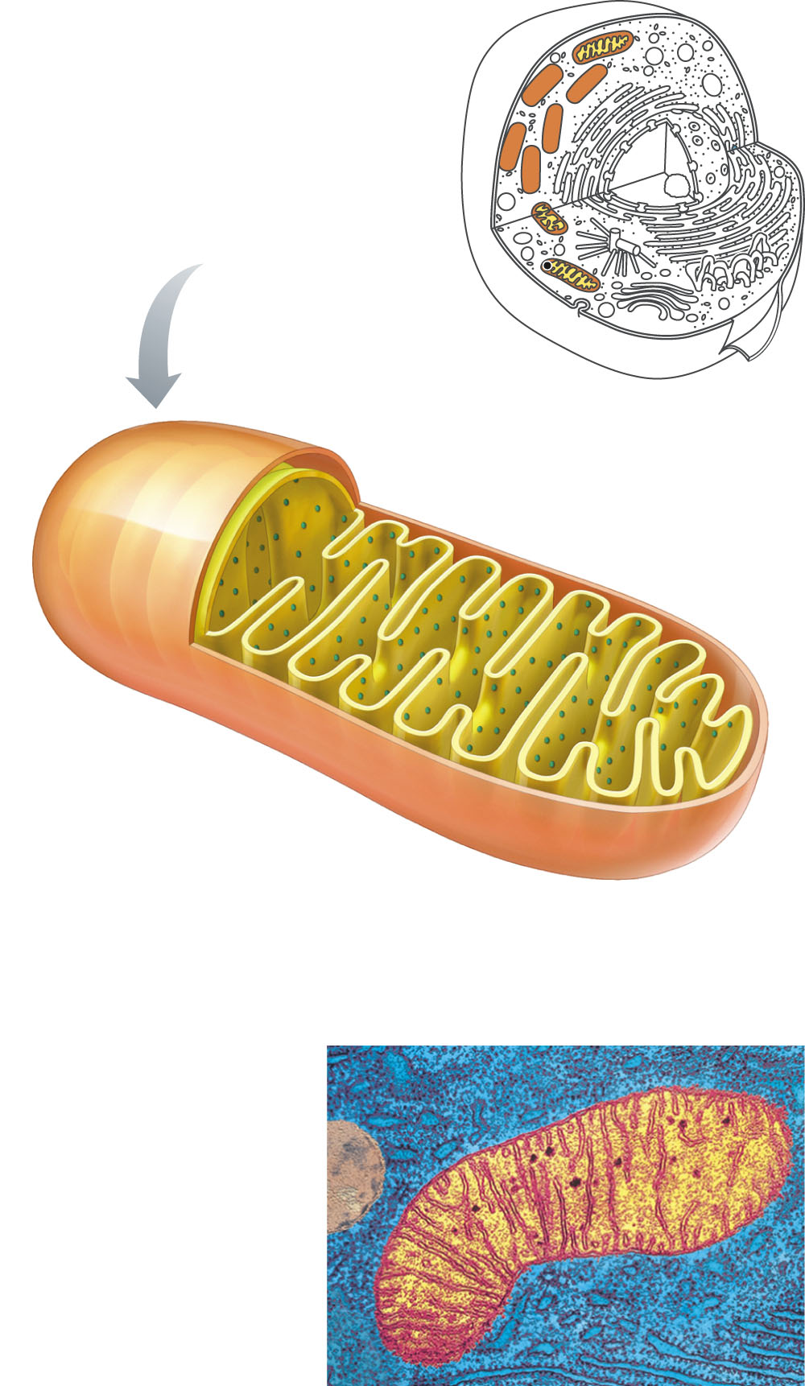
Mitochondrion
Intermembrane
space
Cristae
Proteins of
electron
transport
system
Inner
mitochondrial
membrane
Matrix
Outer
mitochondrial
membrane
Cristae
Figure 2-16 p47
Notes:
FIGURE 2-16 Mitochondrion. Diagram and electron micrograph of a mitochondrion. Note that the outer membrane is smooth while the inner membrane forms folds known as cristae that extend into the matrix. An intermembrane space separates the outer and inner membranes. The electron transport proteins embedded in the cristae are ultimately responsible for converting much of the energy of food into a usable form.

Slide 9
2.8 Mitochondria and Energy Metabolism
Aerobic metabolism in mitochondria relies on O₂ to convert energy in food into ATP.
Aerobic pathways require consumption of O₂
Anaerobic pathways can proceed in the absence of O₂
Energy is released when electrons are transferred from high-energy bonds to electron acceptors in oxidation-reduction reactions
Notes:
9

Slide 10
2.8 Mitochondria and Energy Metabolism
splitting
Universal energy carriers
Adenosine triphosphate (ATP) carries a high-energy bond in the terminal phosphate
When the terminal phosphate bond is split, energy is released
ATP ADP + P_{i} + energy
Nicotinamide adenine dinucleotide (NADH) carries energy-rich electrons that can be used to reduce other organic molecule
Each NADH is worth almost 3 ATPs
Electrons of NADH are transferred to O₂, the final electron acceptor
Notes:
10

Slide 11
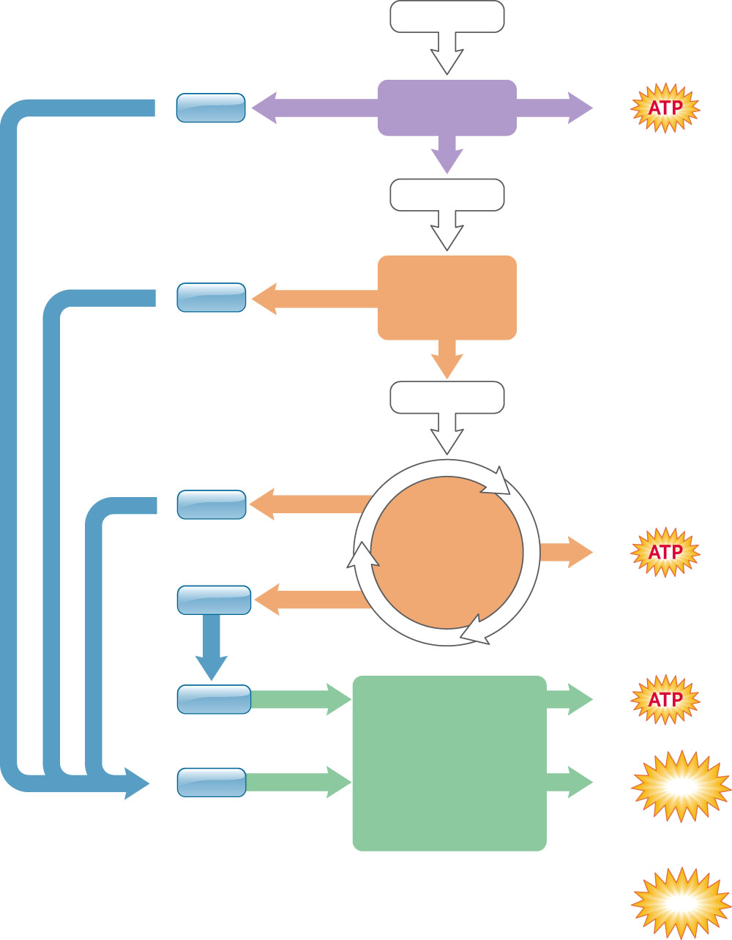
1
Glucose
2
NADH
Glycolysis
2
Cytosol
2
Pyruvate
2
Pyruvate
to acetate
NADH
2
Acetyl-CoA
Mitochondrial matrix
6
NADH
2 turns
of citric
acid cycle
2
2
FADH₂
Electron
transfer
2
FADH₂
2 x 1.5 ATP/FADH₂
3
Electron
transfer
Mitochondrial
inner membrane
10
NADH
10 x 2.5 ATP/NADH
Oxidative
phosphorylation
25
ATP
Total 32
ATP
Figure 2-17 p49
Notes:
FIGURE 2-17 Summary of ATP production from the complete oxidation of one molecule of glucose. The total of 32 ATP assumes that electrons carried by each NADH yield 2.5 ATP and those carried by each FADH2 yield 1.5 ATP during oxidative phosphorylation.

Slide 12
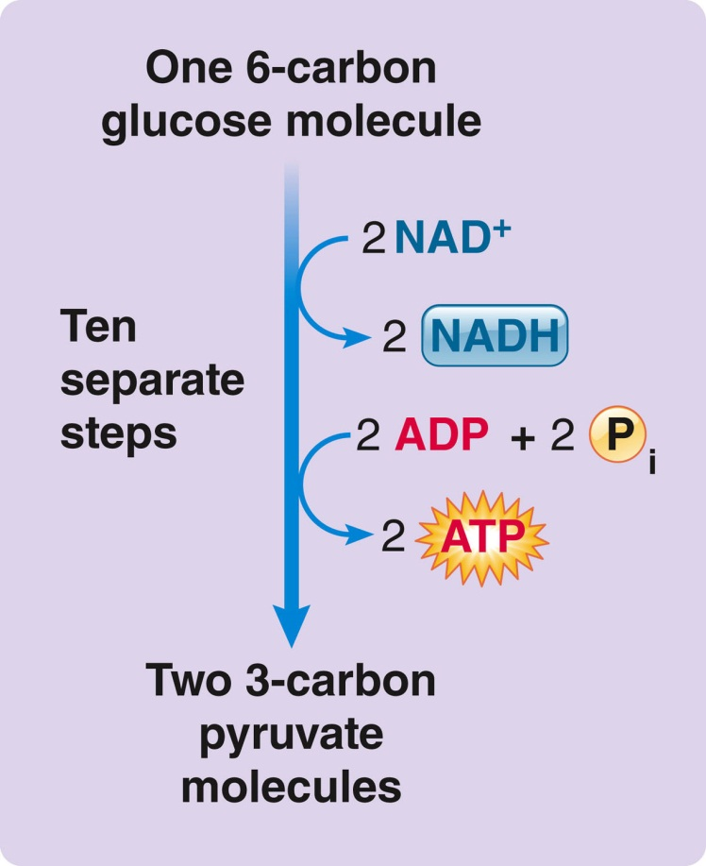
2.8 Mitochondria and Energy Metabolism
Glycolysis
Chemical process that breaks down glucose into two pyruvate molecules
Involves 10 sequential reactions, each catalyzed by a separate enzyme
Notes:
12

Slide 13
2.8 Mitochondria and Energy Metabolism
Glycolysis
All glycolytic enzymes are found in the cytoplasm
Glycolysis can proceed in the absence of oxygen (anaerobic conditions)
Releases two electrons that are transferred to NAD⁺ to form NADH
Not very efficient -- one molecule of glucose yields only two molecules of ATP
Notes:
13

Slide 14
2.8 Mitochondria and Energy Metabolism
Citric acid cycle
Cyclical series of 8 reactions catalyzed by enzymes in the mitochondrial matrix
Pyruvate produced by glycolysis enters the mitochondrial matrix
Pyruvate is converted to acetyl CoA by removal of a carbon and formation of CO₂
Notes:
14

Slide 15
2.8 Mitochondria and Energy Metabolism
Citric acid cycle
Acetyl CoA enters the citric acid cycle by combining with oxaloacetic acid to form citric acid
Two carbons are released as CO₂
One ATP is produced for each turn of the cycle
The key purpose of the cycle is to produce hydrogens for entry into the electron transport chain
Notes:
15

Slide 16
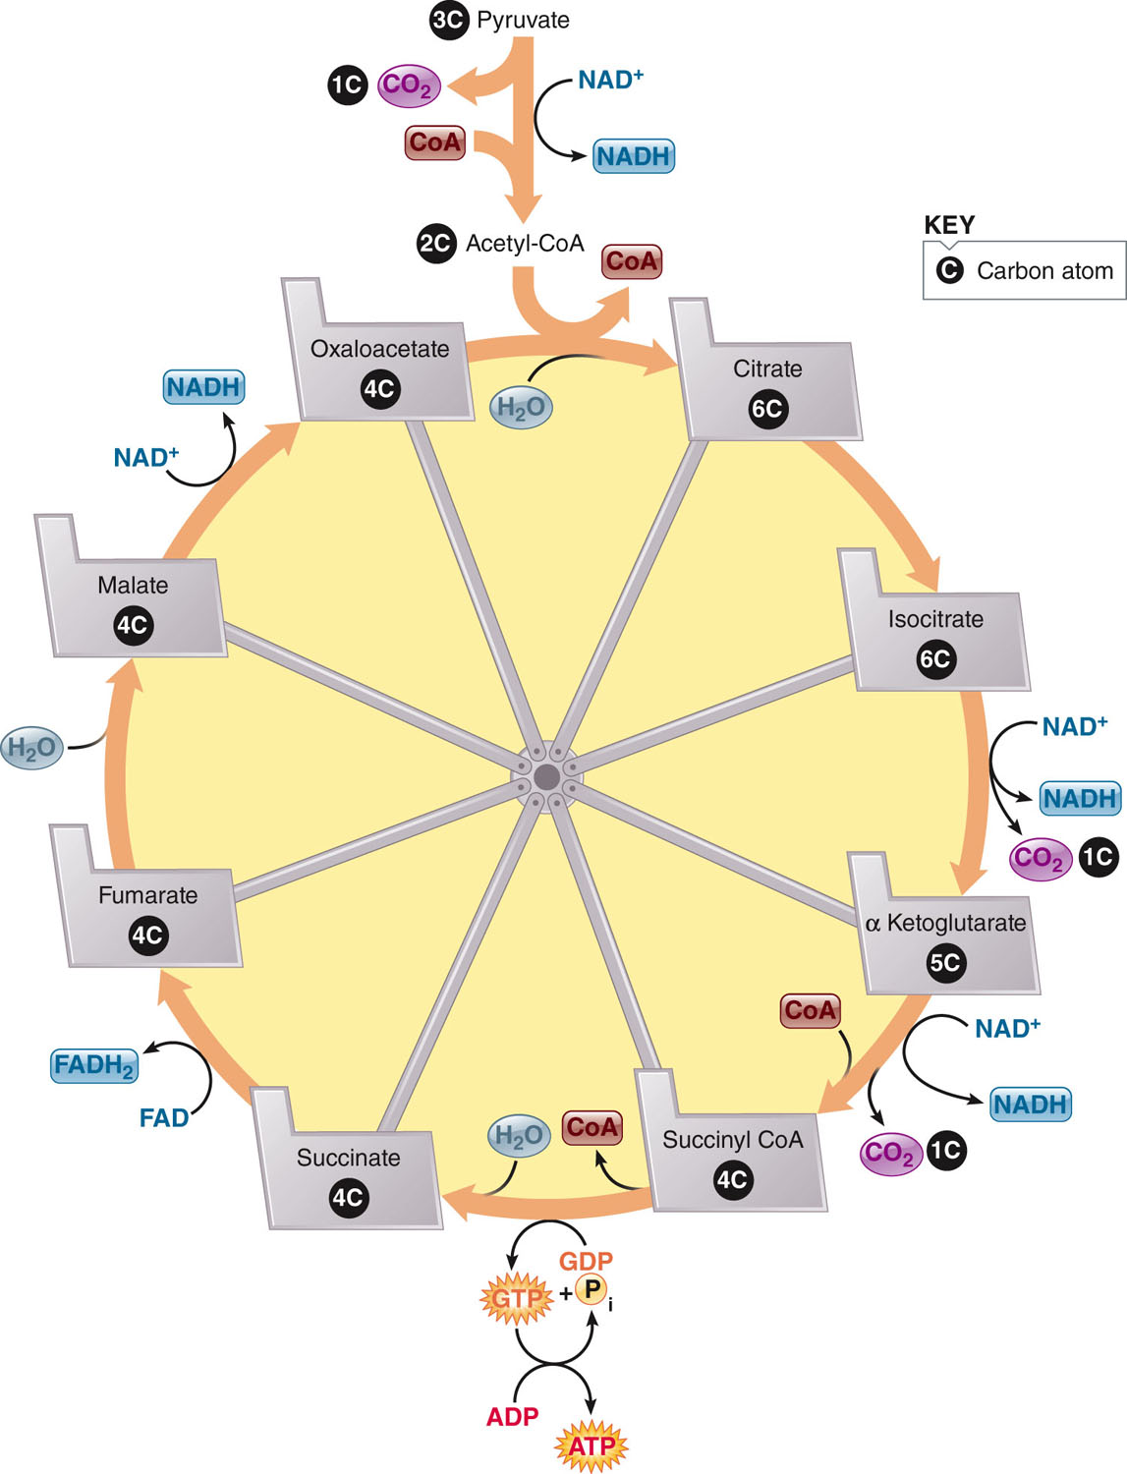
2.8 Mitochondria and Energy Metabolism
Notes:
16

Slide 17
2.8 Mitochondria and Energy Metabolism
Electron transport chain
Electron carrier molecules are located in the inner mitochondrial membrane
Electrons are transferred through a chain of reactions with the electrons falling to lower energy levels at each step
O₂ is the final electron acceptor of the electron transport chain (also called respiratory chain)
O₂ combines with electrons and hydrogen to form H₂O
Notes:
17

Slide 18
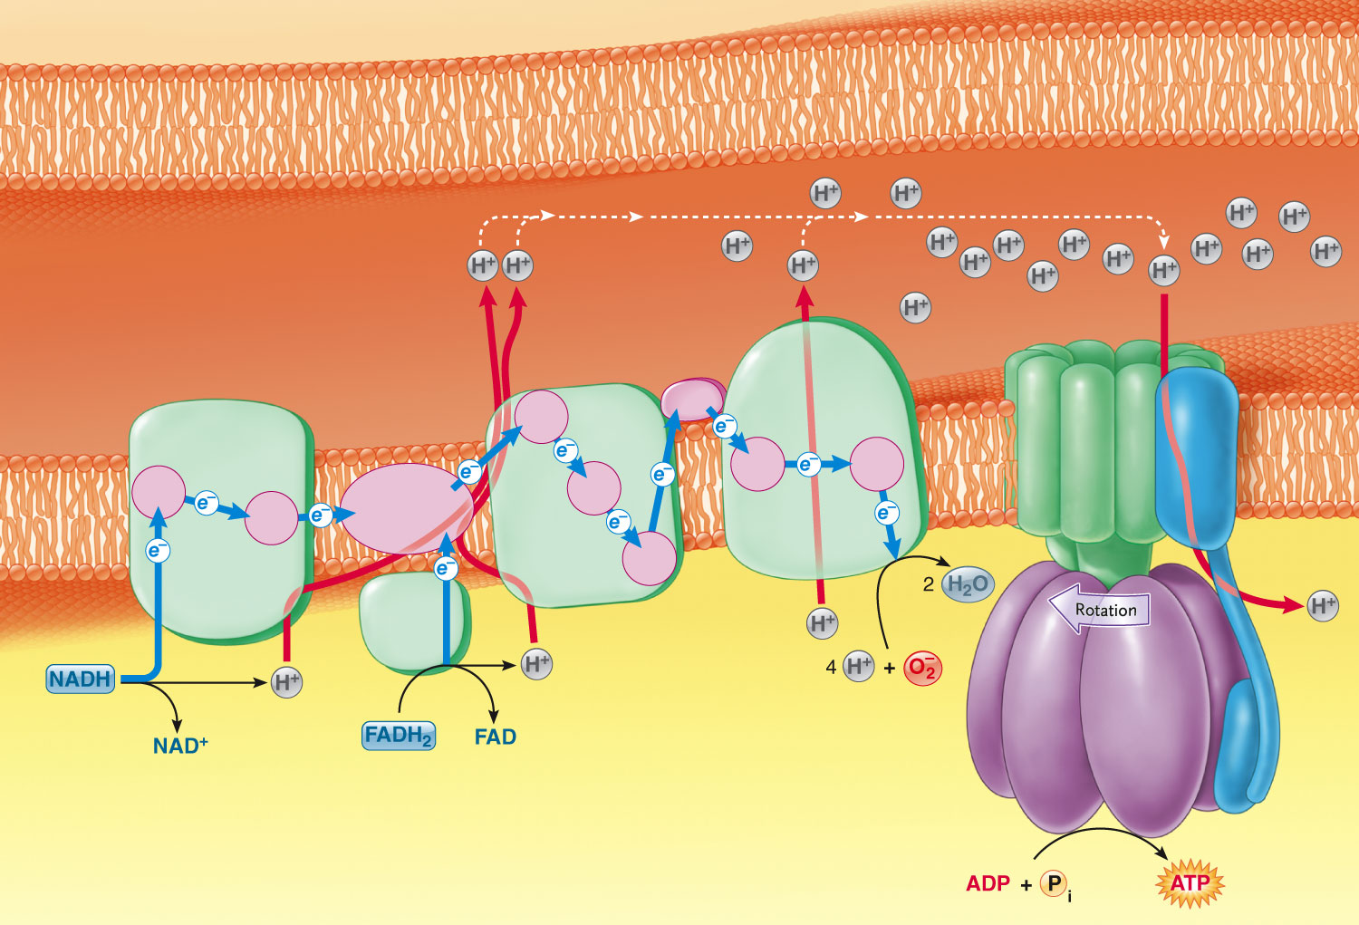
Cytosol
Outer mitochondrial
membrane
6
High H+
Intermembrane
space
ATP
synthase
3
3
Inner
mito-
chondrial
membrane
3
Complex
III
Complex
IV
Complex
I
Complex
II
5
4
5
1
1
Head-
piece
6
Low H+
2
2
Mitochondrial
matrix
9
Electron transport system
Electrons flow through a series of electron carriers from high-energy to low-energy levels;
the energy released builds an H+ gradient across the inner mitochondrial membrane.
Chemiosmosis
ATP synthase catalyzes ATP synthesis using energy from the H+ gradient across the membrane.
Oxidative phosphorylation
Figure 2-20 p52
Notes:
FIGURE 2-20 Oxidative phosphorylation at the mitochondrial inner membrane. Oxidative phosphorylation involves the electron transport system (steps 1–6) and chemiosmosis by ATP synthase (steps 7–9). The pink circles in the electron transport system represent speciﬁc electron carriers.

Slide 19
2.8 Mitochondria and Energy Metabolism
Electron transport chain
Some of energy released during transfer of electrons is used to synthesize ATP (oxidative phosphorylation)
Total ATP yield is 30 ATPs per molecule of glucose
Food + O₂ CO₂ + H₂O + ATP
(necessary for (produced (produced
oxidative primarily by the primarily by
phosphorylation) citric acid cycle) the electron
transport chain)
Notes:
19

Slide 20
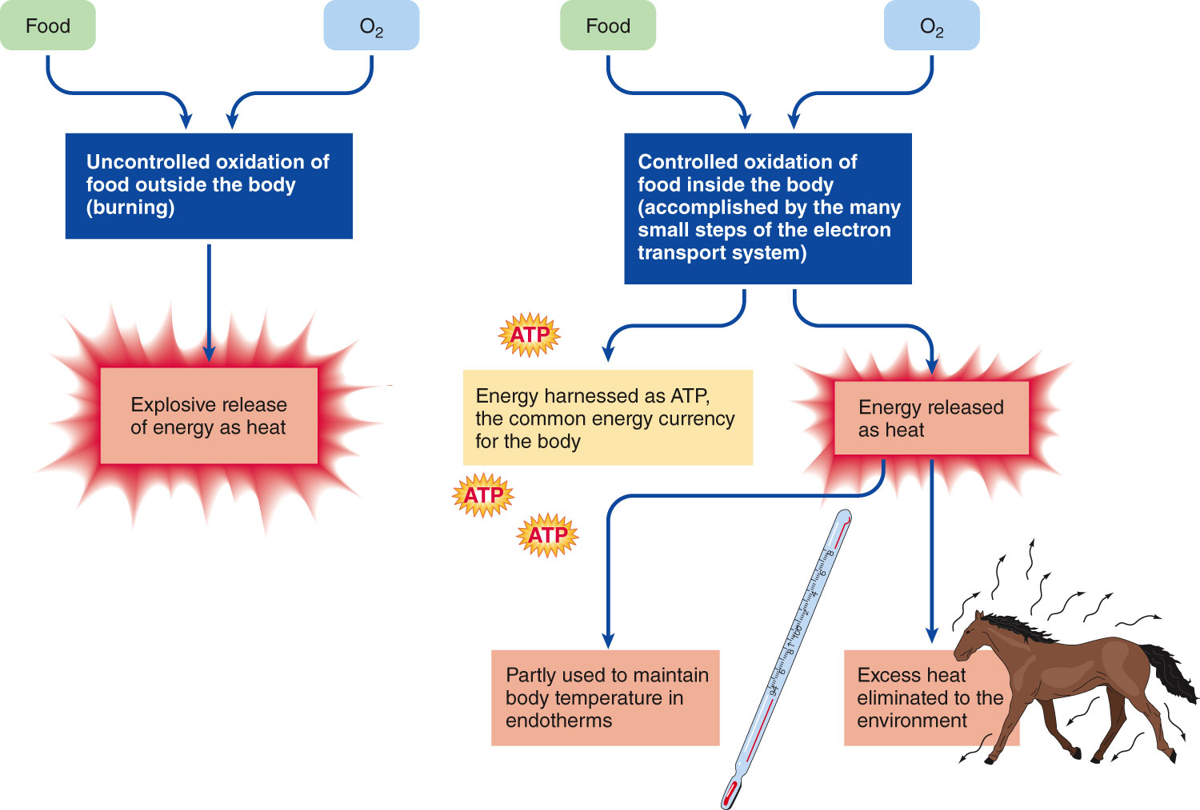
2.8 Mitochondria and Energy Metabolism
Notes:
20

Slide 21
2.8 Mitochondria and Energy Metabolism
Metabolism under anaerobic conditions
O₂ deficiency forces cells to rely on glycolysis
Pyruvate is converted to lactate
Lactate accumulates in the tissues and reduces pH
Lactate can be converted back to pyruvate
Notes:
21

Slide 22
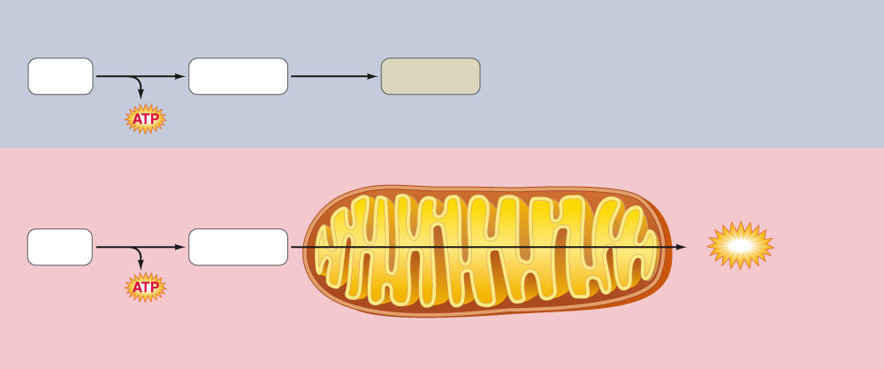
Anaerobic conditions
No O₂
available
Glycolysis
Glucose
Pyruvate
Lactate
2
Aerobic conditions
Mitochondrial
membranes
Glycolysis
O₂ available
Glucose
Pyruvate
30
ATP
+ CO₂+H₂O
Citric acid cycle/Oxidative
phosphorylation
2
Cytosol
Mitochondrion
Figure 2-23 p56
Notes:
FIGURE 2-23 Comparison of energy yield and products under anaerobic and aerobic conditions. In anaerobic conditions, only 2 ATP are produced for every glucose molecule processed, but in aerobic conditions a total of 32 ATP are produced per glucose molecule.

Slide 23
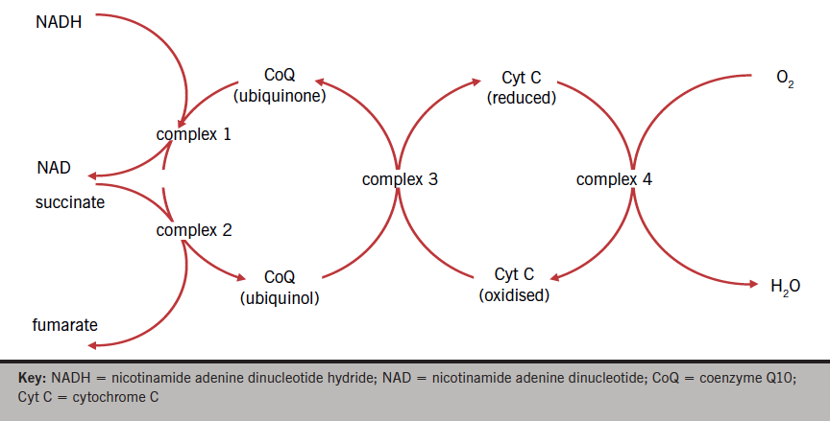
Coenzyme Q10 in Mitochondria
https://bjcardio.co.uk/2015/10/coenzyme-q10-and-cardiovascular-disease-an-overview/

Slide 24
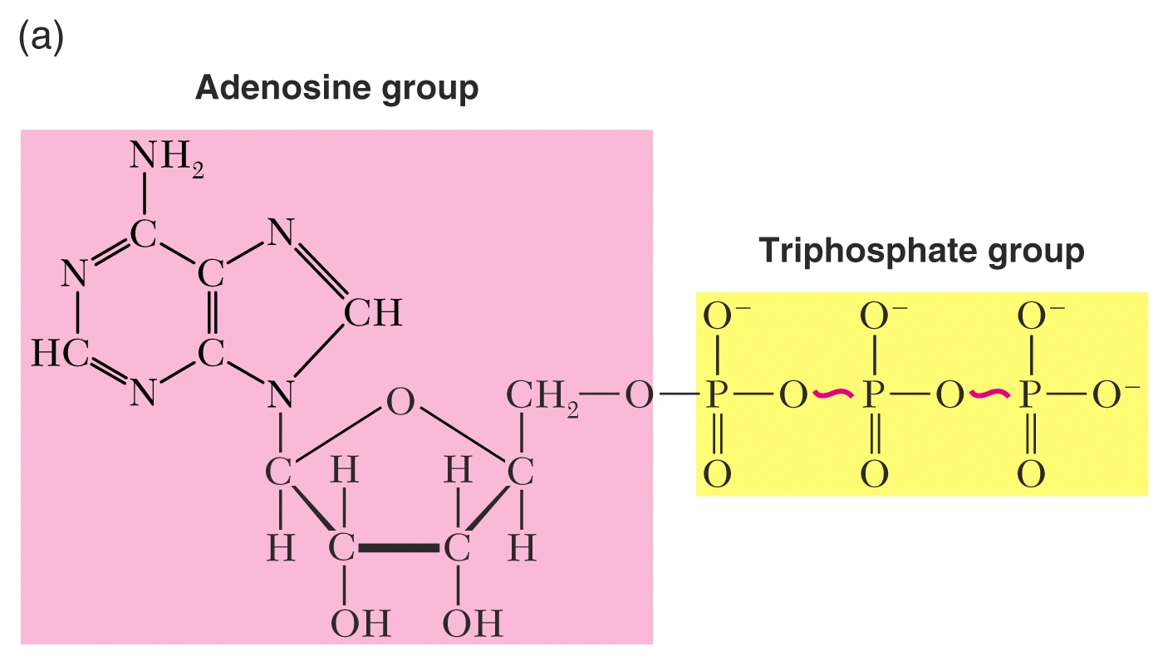

Slide 25
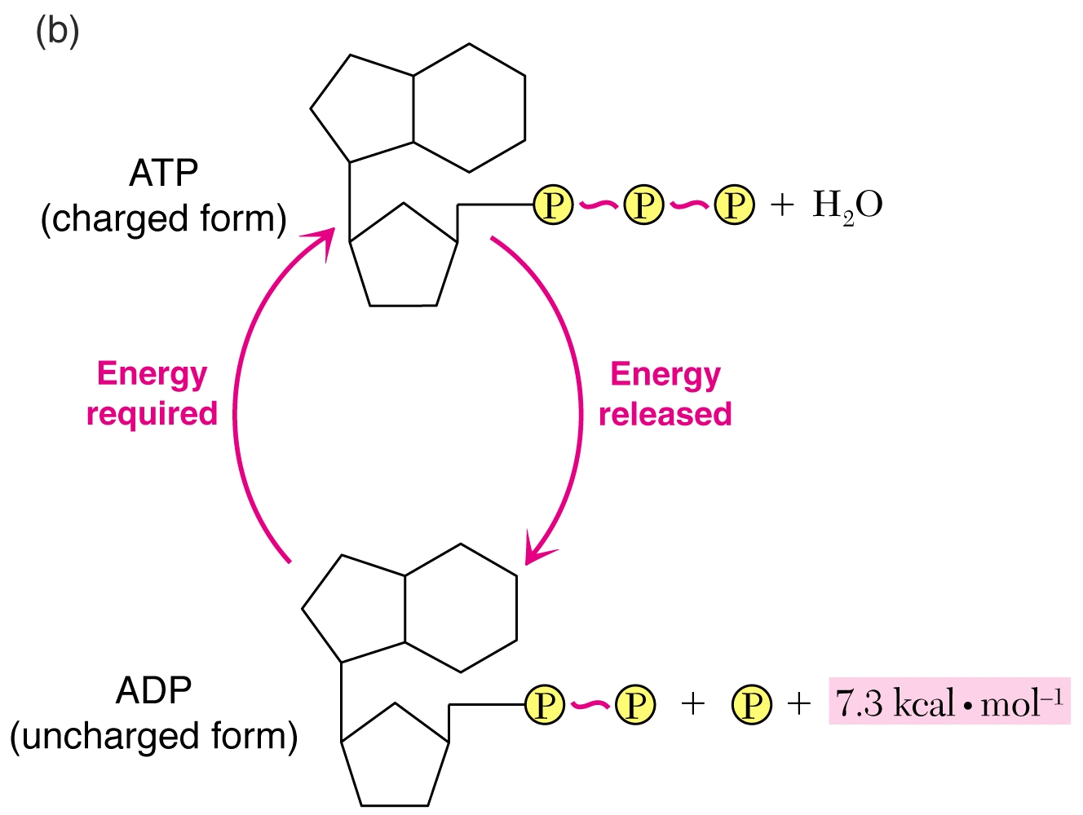

Slide 26
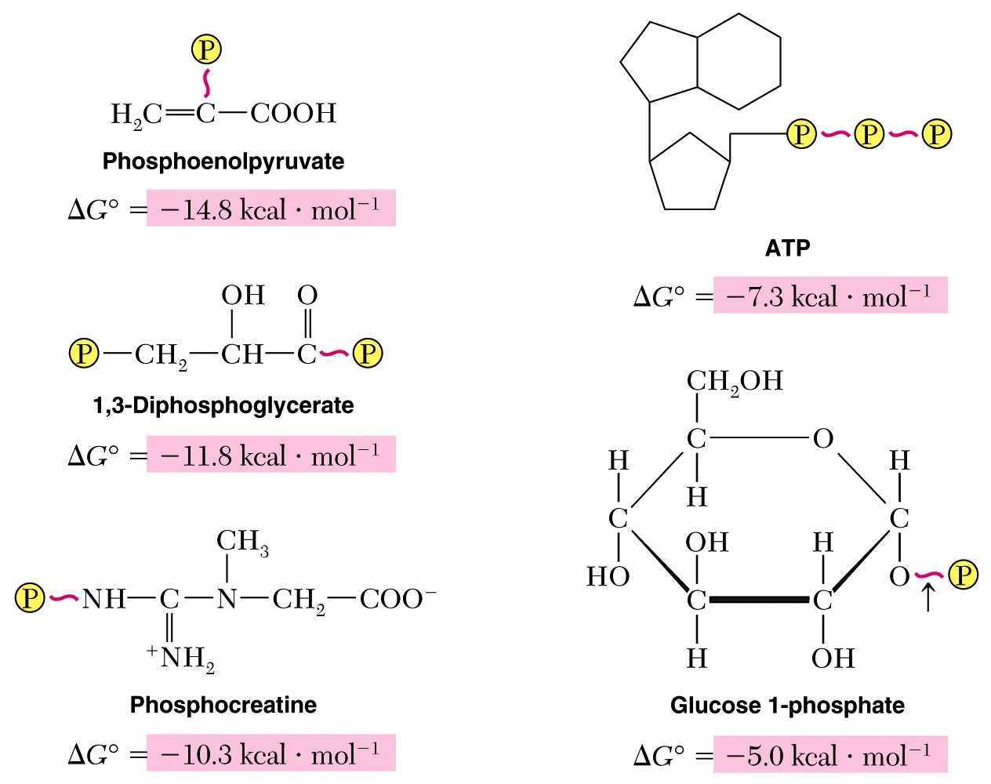

Slide 27
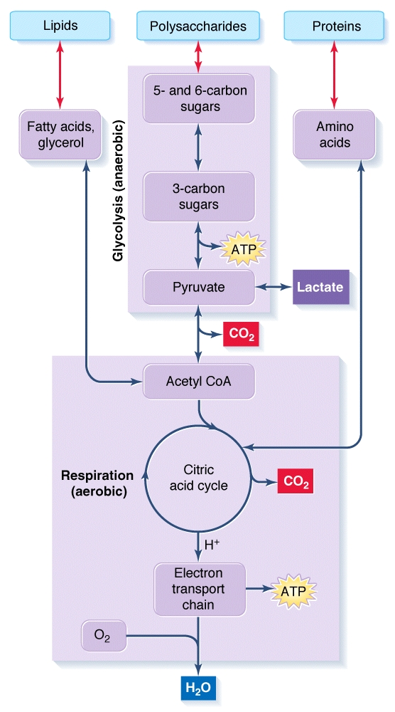
2 ATP
36 ATP (?)
Total 38 ATP (?)

Slide 28
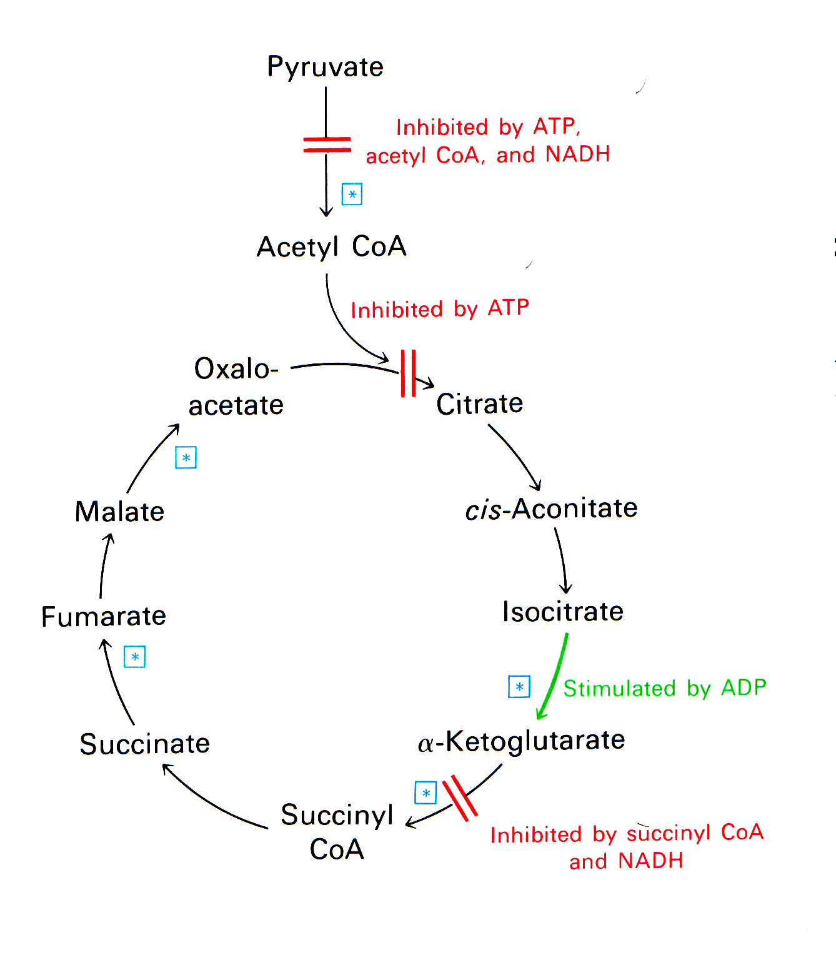

Slide 29
Endosymbiotic theory
Lynn Margulis
https://en.wikipedia.org/wiki/Lynn_Margulis

Slide 30
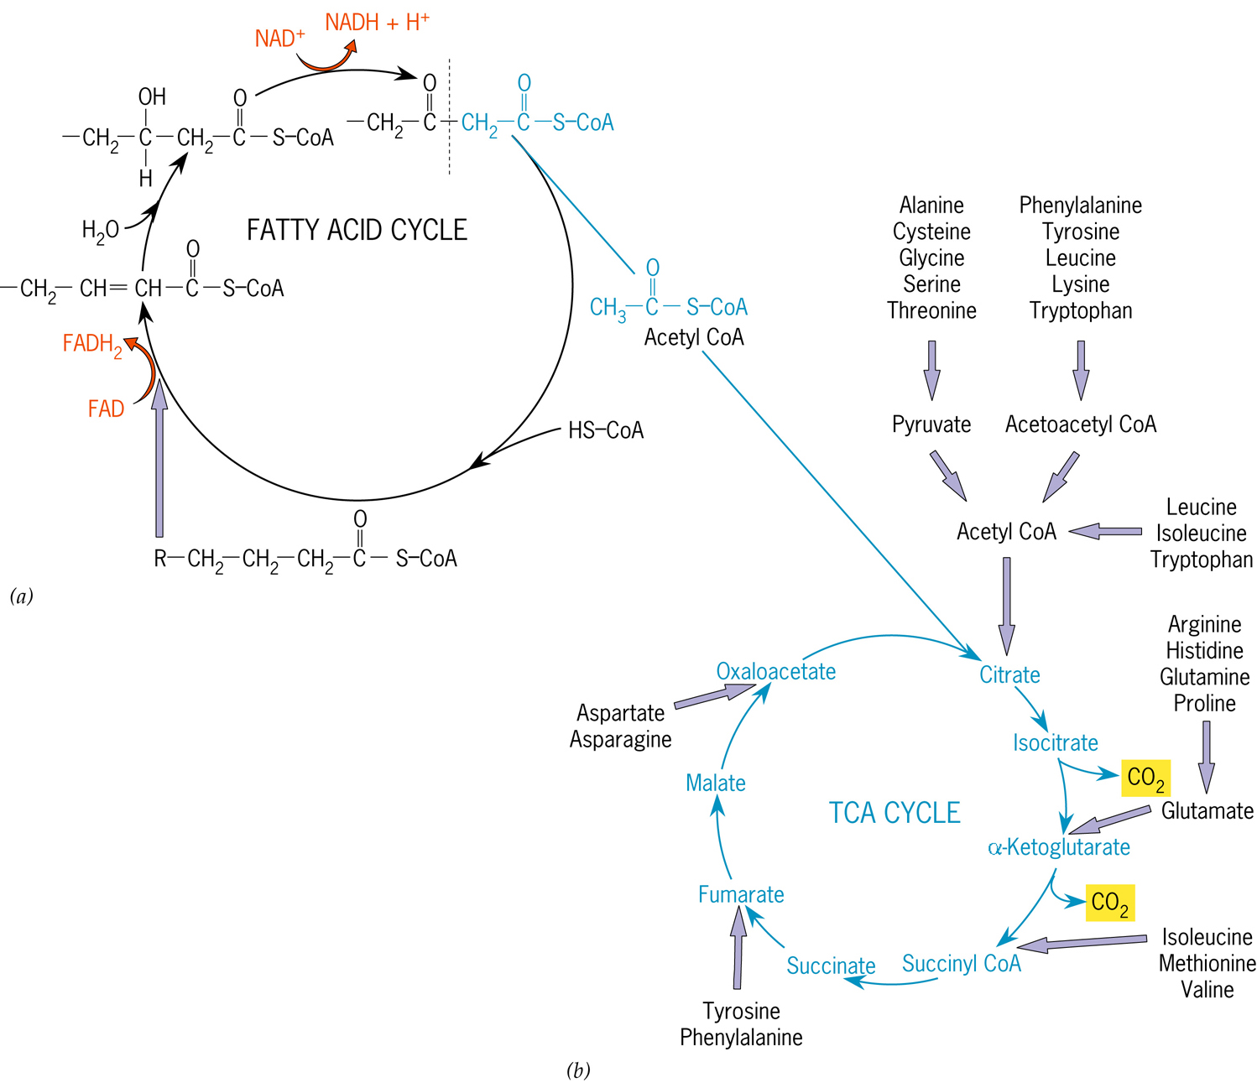

Slide 31
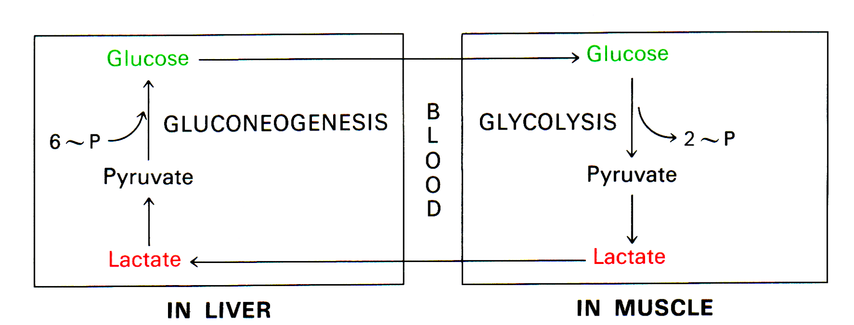

Slide 32
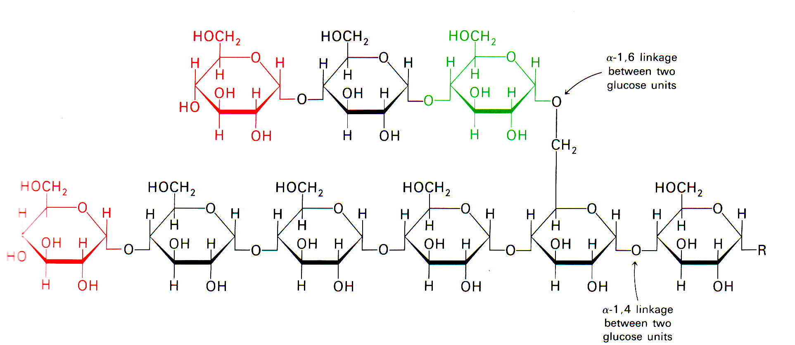
Glycogen-storage of glucose

Slide 33
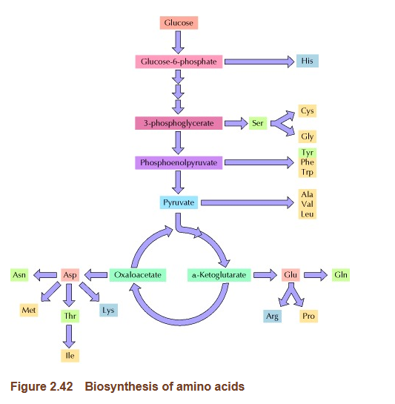
AA to glucose ?
Glucose to AA
(make amino acid from glucose ?)
https://en.wikipedia.org/wiki/Glucogenic_amino_acid
https://www.ncbi.nlm.nih.gov/books/NBK9956/#:~:text=The%20raw%20material%20for%20amino,synthesize%20all%2020%20amino%20acids.

Slide 34
Any other steps ?
Glucose to DNA ??
https://pmc.ncbi.nlm.nih.gov/articles/PMC6814379/

Slide 35
CO2 in body to make Proteins ?
????? Miller-Urey experiment

Slide 36
Miao J, Qian Q, Zand L. Long-Standing Hypokalemia and Lactic Acidosis as the Primary Presentation of Mitochondrial Myopathy. Kidney Int Rep. 2020 Feb 5;5(5):742-745. doi: 10.1016/j.ekir.2020.01.021. PMID: 32405597; PMCID: PMC7210602.
https://pmc.ncbi.nlm.nih.gov/articles/PMC7210602/#:~:text=Lactic%20acid%20typically%20accumulates%20in,in%20the%20electron%20transport%20chain.

